Slide 1
In this lecture we will learn Vertical stacking and Horizontal stacking in numpy.

Slide 2
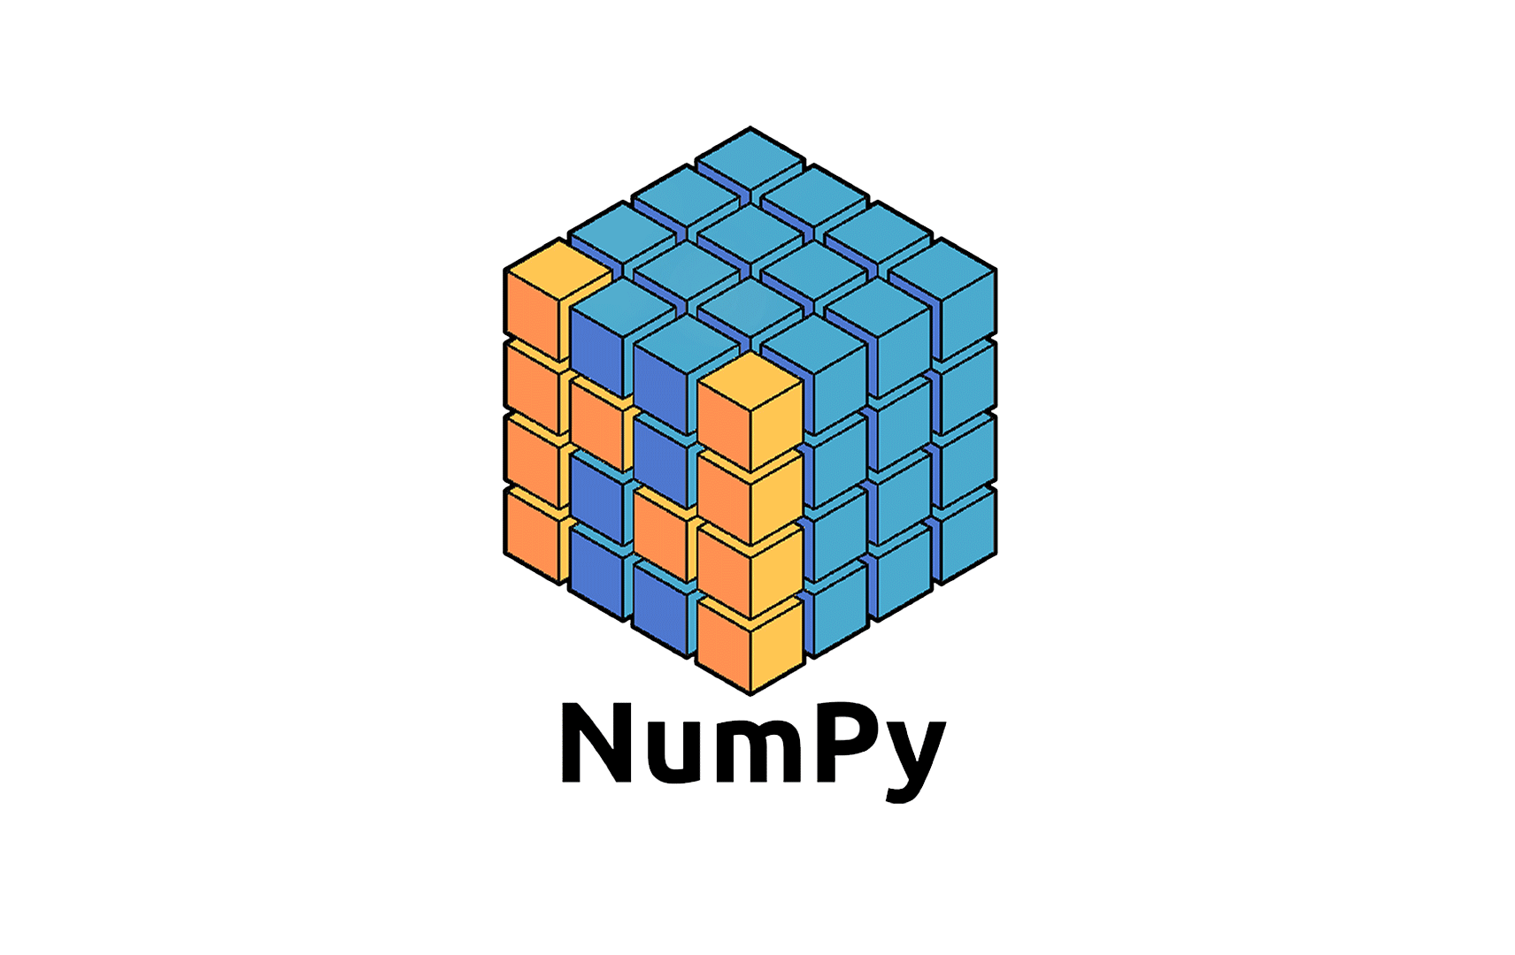
Numpy
Part 10
Arvind Kharwal
www.Kharwal.com

Slide 3
Numpy Operations

Slide 4
Vertical Stacking using vstack()
Horizontal Stacking using hstack()

Slide 5
Vertical Stacking:
numpy.vstack() function is used to stack the sequence of input arrays vertically to make a single array.
All the input arrays must have the same dimensions.

Slide 6
Horizontal Stacking:
numpy.hstack() function is used to stack the sequence of input arrays horizontally to make a single array.
All the input arrays must have the same dimensions.

Slide 17
Thank You

